Slide 1
VIDEO GAME SALES
Analytics Dashboard
Global Sales Trends by Platform, Genre & Publisher (1980–2020)
Interactive Power BI dashboard + presentation summary
Prepared for business stakeholders

Slide 2
1. Objective & Dataset
Objective
Dataset Overview
• Analyze global video game sales across regions.
• Compare performance by platform, genre and publisher.
• Identify yearly trends and peak sales periods.
• Provide interactive insights for business stakeholders.
• 16,598 game titles in the dataset.
• 8,920.44 million total global sales.
• Regional measures: North America, Europe, Japan and Other.
• Key dimensions: Year, Platform, Genre and Publisher.

Slide 3
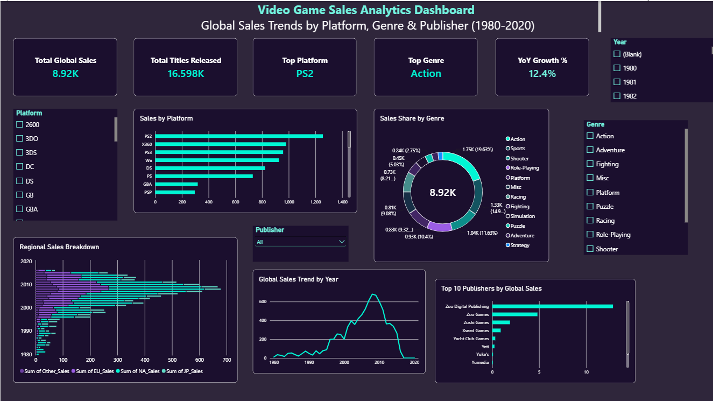
2. Interactive Dashboard

Slide 4
3. Key Performance Indicators
8.92K
16.60K
PS2
Action
Total Global Sales
Titles Released
Top Platform
Top Genre
8,920.44M in source data
16,598 records
1,255.64M sales
1,751.18M sales
Business Insights
• PS2 is the strongest platform by cumulative global sales.
• Action is the leading genre by global sales.
• Sales reached their highest annual level around 2008 (678.90M).
• The dashboard makes it easy to compare market performance across time and categories.

Slide 5
4. Dashboard Features
KPI Cards
Platform Analysis
Quick summary of sales, titles, leading platform, leading genre and growth.
Horizontal bar chart ranks platforms by global sales.
Genre Share
Time-Series Trend
Donut chart shows how global sales are distributed across genres.
Line chart highlights changes in global sales over the years.
Regional Breakdown
Slicers / Filters
Compares NA, EU, JP and Other sales across years.
Year, platform, genre and publisher filters support interactive exploration.

Slide 6
5. Conclusion
What the dashboard delivers
• A single view of global video game sales performance.
• Fast identification of high-performing platforms and genres.
• Clear understanding of sales movement over time.
• Interactive filters allow stakeholders to investigate specific segments.
• The design combines KPI cards, charts and slicers for concise decision support.
Overall takeaway: The dashboard converts raw sales data into an interactive business story.
Thank You

